Slide 1
Unit 4: Machine Learning
CUNY LaGuardia Community College

Slide 2
What is machine learning?
“Learning is any process by which a system improves performance from experience.” – Herbert Simon
According to Arthur Samuel, Machine Learning algorithms enable the computers to learn from data, and even improve themselves, without being explicitly programmed.
Machine learning (ML) is a category of an algorithm that allows software applications to become more accurate in predicting outcomes without being explicitly programmed.

Slide 3
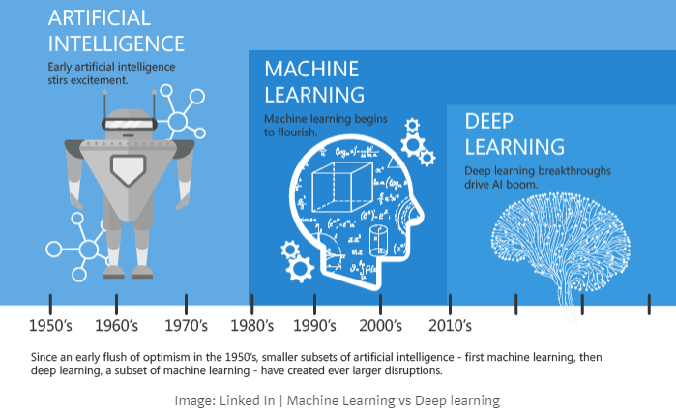
Quick History of Machine Learning

Slide 4

Data science
Seeds = Algorithms
Nutrients = Data
Gardener = You
Plants = Programs

Slide 5
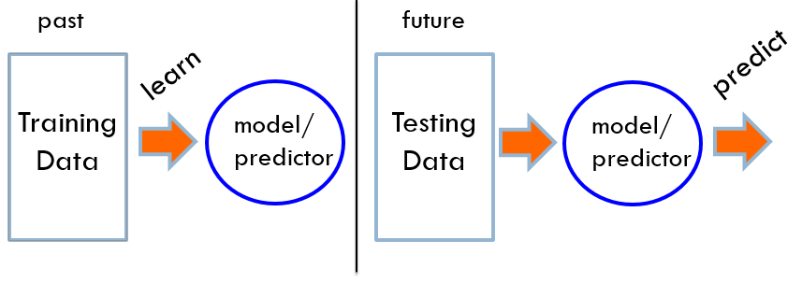
Machine learning
“Machine learning is about predicting the future based on the past.” – Hal Daume III

Slide 6
Machine learnin
What high-level machine learning problems have you seen or heard about before?

Slide 7
Types of Machine Learning
Machine learning can be classified into 3 main types of algorithms.
Supervised learning
Unsupervised learning
Reinforcement learning

Slide 8
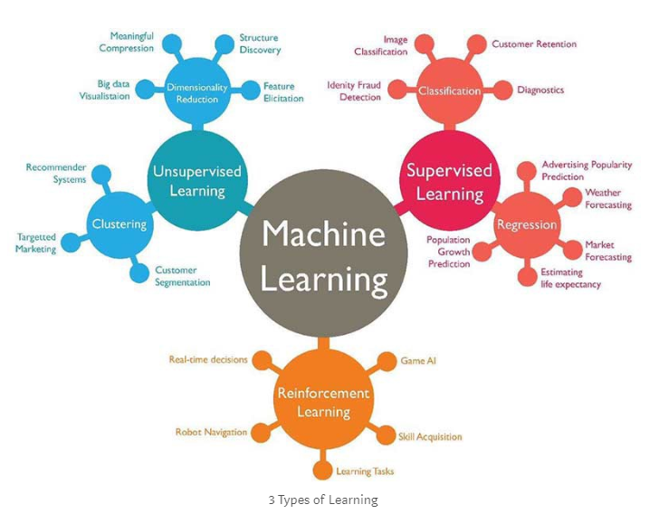
Types of machine learning
towardsdatascience.com

Slide 9
Supervised learning
In supervised learning, the machine learning model is given labeled data – which means each row of data is tagged with the correct label.
The goal is to use your training data to create a model that can predict the correct label on new data.

Slide 10
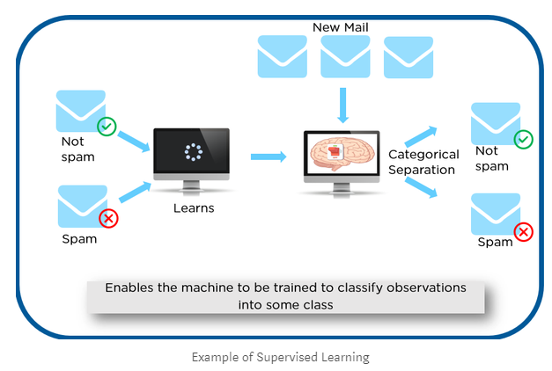
Supervised learning
towardsdatascience.com
Labeled data (spam or not spam) is fed into a machine learning model. That model then takes in new data and predicts if its spam or not spam based on previous data.

Slide 11
Types of Supervised learning
Regression: when the output is a real value, such as dollars, weight, height, etc.
Classification: when the variable is a category, such as: yes/no, 1/0, spam/not spam.

Slide 12
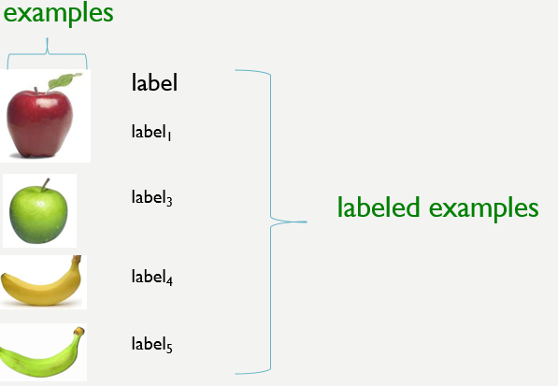
Supervised learning

Slide 13
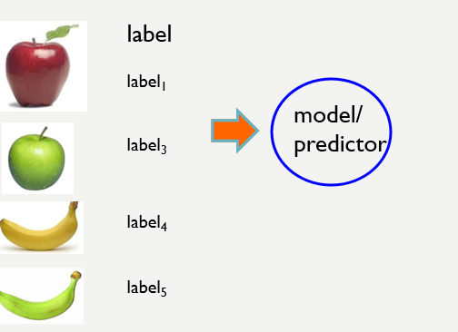
Supervised learning

Slide 14
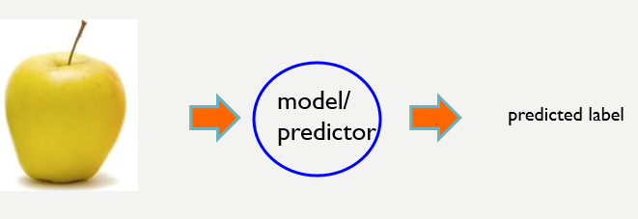
Supervised learning

Slide 15
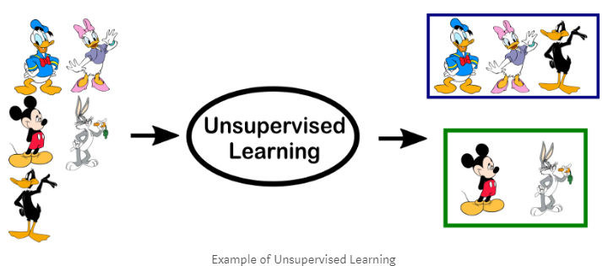
Unsupervised learning
In unsupervised learning, the machine learning model is presented data that is unlabeled. The model works on this uncategorized data without any prior training. Unsupervised models look for patterns in the data to make their predictions.
towardsdatascience.com

Slide 16
Types of Unsupervised learning
Clustering: allows you to discover inherent or hidden groups within your data. For example, grouping customers based on energy usage, or customer age, or a mixture of multiple variables.
Association: allows you to discover rules that describe portions of your data, such as people that buy this are more likely to buy that.

Slide 17
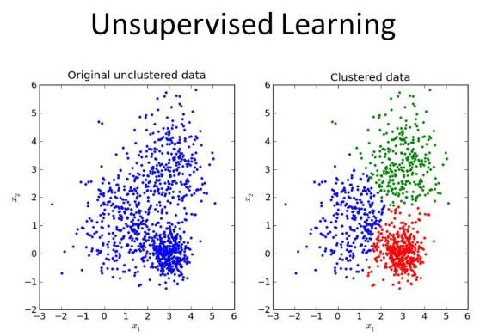
Unsupervised learning
Medium.com

Slide 18
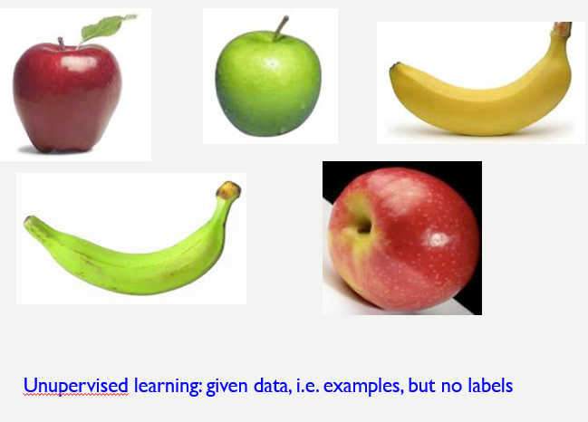
Unsupervised learning

Slide 19
Reinforcement learning
Reinforcement algorithms learn from interacting with data. Each time the algorithm, or agent, gets the correct answer, it is rewarded with + points. If it selects the incorrect answer, it loses points.

Slide 20
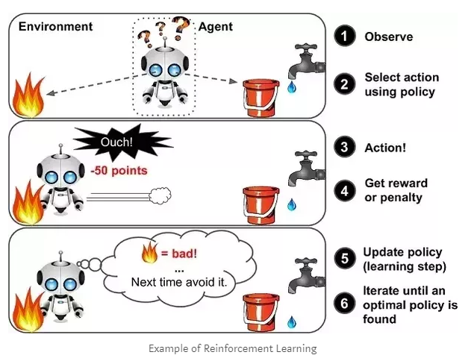
Reinforcement learning

Slide 21
Reinforcement learning
left, right, straight, left, left, left, straight
GOOD
left, straight, straight, left, right, straight, straight
BAD
left, right, straight, left, left, left, straight
18.5
left, straight, straight, left, right, straight, straight
-3
Given a sequence of examples/states and a reward after completing that sequence, learn to predict the action to take in for an individual example/state

Slide 22
WHEN IS MACHINE LEARNING USED? Examples …
Human expertise doesn’t exist (navigating on Mars)
Machine learning can be used for machines to navigate their surroundings by identifying their environment
Healthcare
Models can be used to scan databases of thousands, or even millions of images. This can be used to look at new images and predict diagnosis of patients.
Understand risk factors for diseases in large populations
Fraud Detection
Recommendation systems
Amazon, Netflix, etc.
Online searching
Google
Smart cars
Tesla

Slide 23
WHEN IS MACHINE LEARNING USED? Examples …
Recognizing patterns
Facial identities or facial expressions
Handwritten or spoken words
Medical images
Recognizing anomalies
Unusual credit card transactions
Predictions
Future stock prices or current exchange rates
Energy consumption

Slide 24
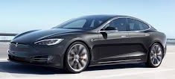
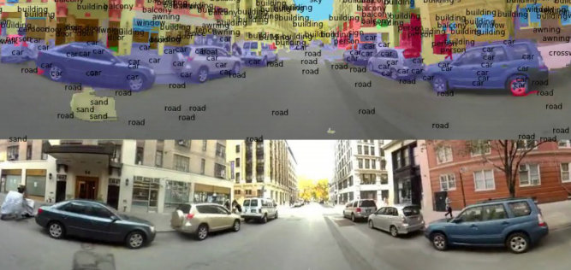
applications of machine learning
Autonomous cars

Slide 25
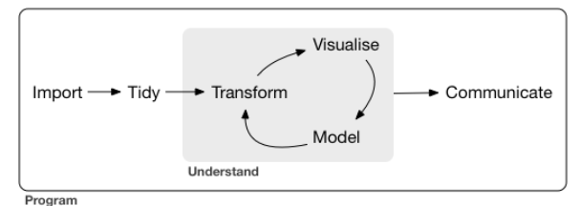
ML in practice

Slide 26
Break – 15 mins

Slide 27
Intro to machine learning
Load and complete the datacamp machine learning free course:
https://www.datacamp.com/community/open-courses/introduction-to-python-machine-learning-with-analytics-vidhya-hackathons

